Slide 1

PUMPKIN SEED FRAMEWORK
UAT GSIP
12.13.2021
Jake A O'Connor

Slide 2

What is it?

Slide 3
Turn-Based Game Framework
Cross-Platform
Genre-Agnostic
Highly Modular

Slide 4

What is the need?

Slide 5
Few Cross-Platform
Nothing Genre-Agnostic

Slide 6
Construction

Slide 7
.NET Core
Multi-Threaded
Software Patterns

Slide 8
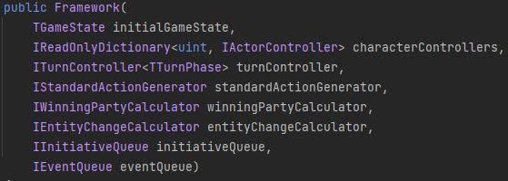
Modular Construction

Slide 9

Basic Building Blocks

Slide 10
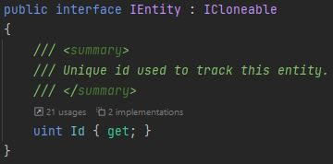
Entities

Slide 11
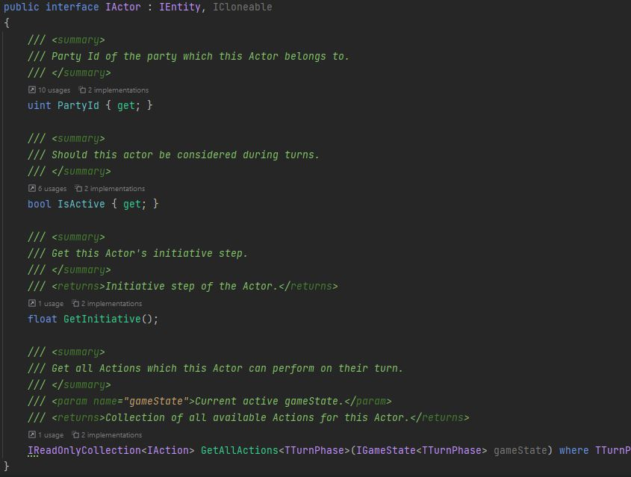
Actors

Slide 12
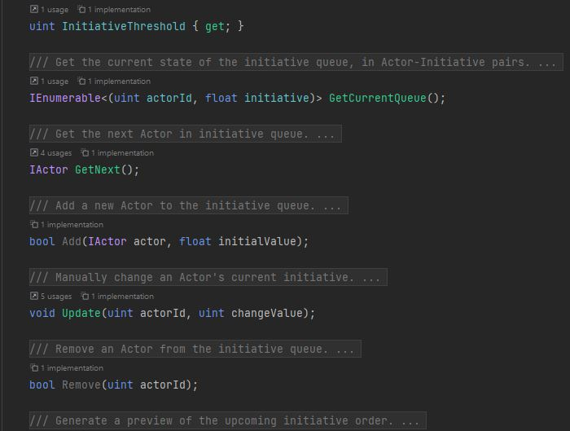
Initiative

Slide 13

Examples

Slide 14
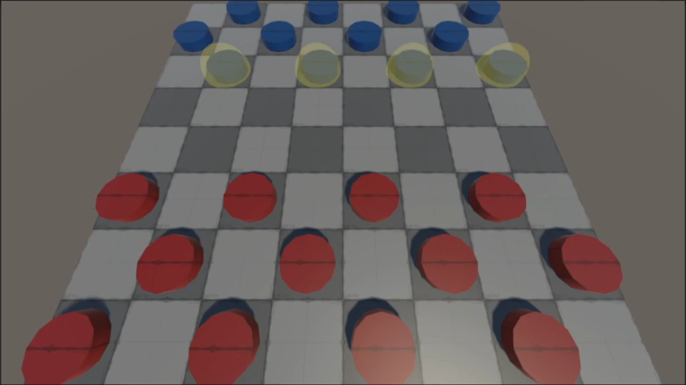
Checkers
Entities
Pieces
Actors
Players

Slide 15
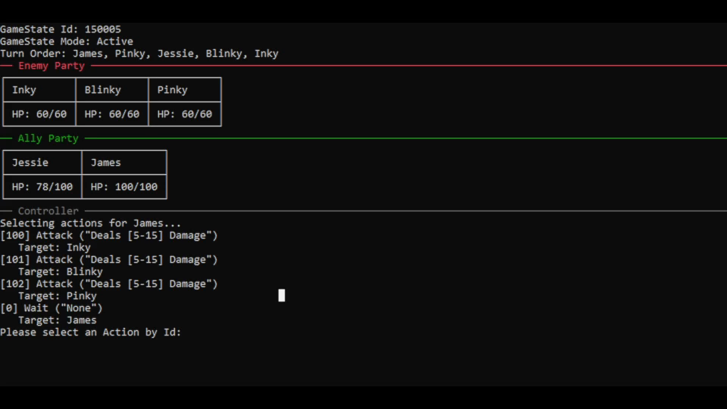
Console RPG
Entities
Actors
Characters
Enemies

Slide 16
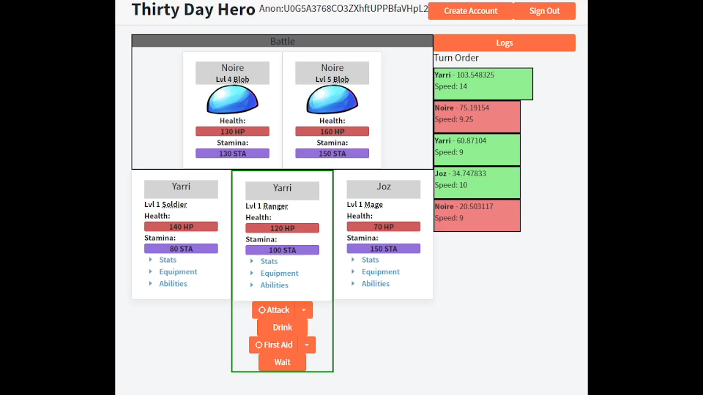
Web Game
Entities
Items
Actors
Characters
Equipment
Enemies

Slide 17
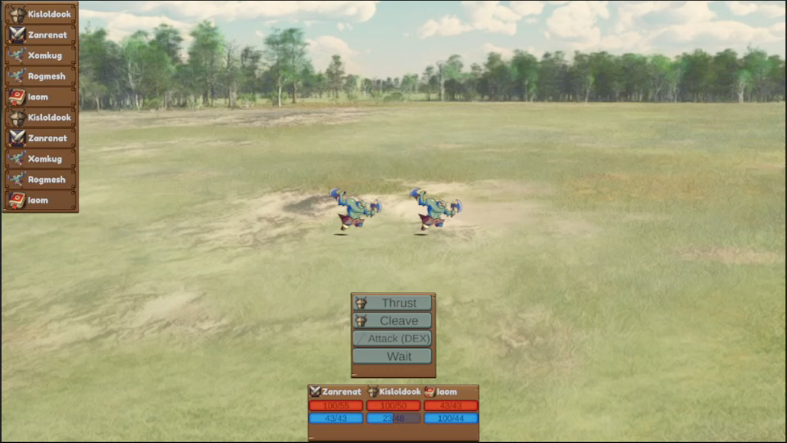
Unity Game
Entities
Items
Actors
Characters
Equipment
Enemies
Status Effects

Slide 18
Pumpkin Seed Framework

